Slide 1

Full Stack Web Development and Database Design
Marehan Waly & Andrew Shen
Dr. Ohno-Machado, Kai Post, Paulina Paul
Notes:
Good Morning Everyone!
We’d like to thank everyone for joining us here today.
I’m Marehan and this is Andrew and our presentation today will be about Full Stack Web Development and Database Design.

Slide 2
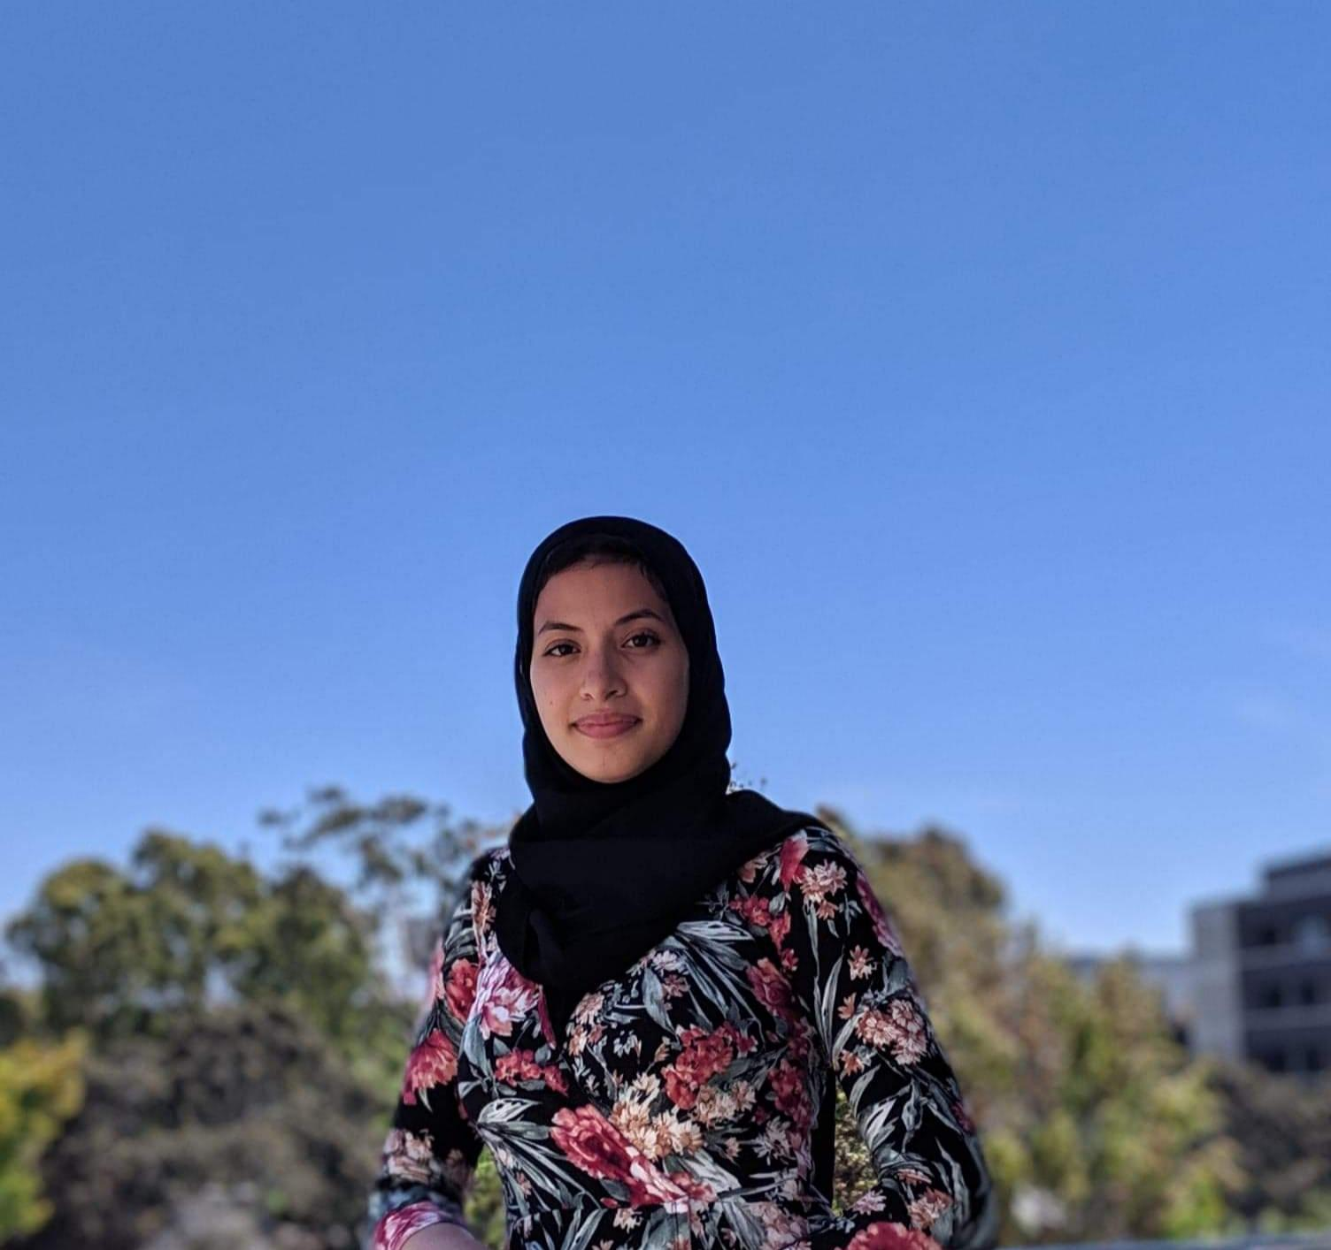
About Me
Upcoming 4th year Computer Science Bioinformatics Major at UCSD
Interested in pursuing an MD/PhD
Basic experience in Python, Java and HTML (Hypertext Markup Language)
Clear Head Picture
Notes:
My name is Marehan. I am an upcoming 4th year Computer Science Bioinformatics major at UCSD
In the near future, I am interested in pursuing an MD/PhD
Coming into this internship, I had basic experience in Python, Java, and HTML

Slide 3

About Me
Upcoming 2nd Year Data Science Major at UCSD
Interested in the practical use of data and web design and development
Experience in Python
Clear Head Picture
Notes:
Hi I am Andrew an incoming 2nd year Data Science major
I’m Interested in the practical use of data and web design and development
Coming into this internship I only had experience in python

Slide 4
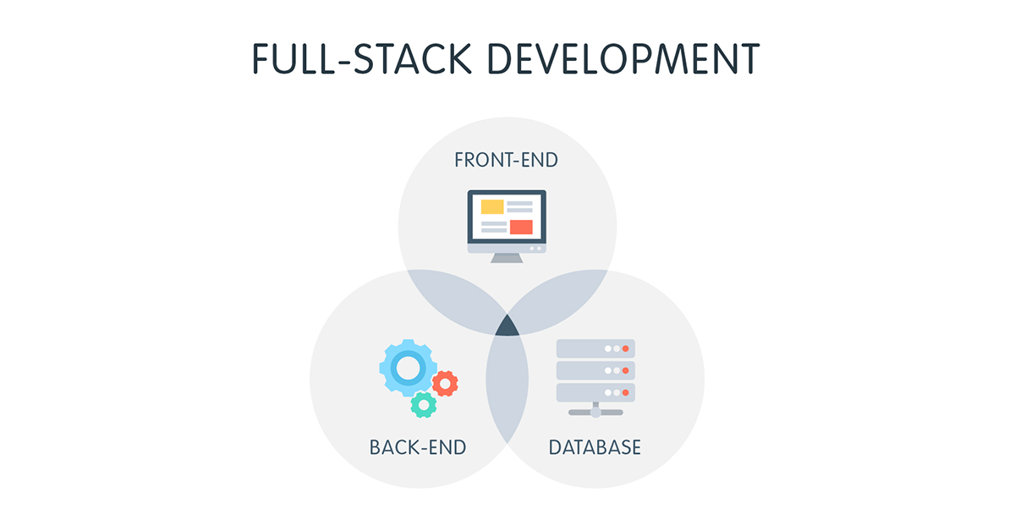

Outline
The Problem
The Benefits of Our Implementation
The Interface
The Database
Future Plans
What We Learned
Notes:
In today’s presentation, first we will discuss the problem our project has aimed to solve
Then, we will discuss the benefits of our implementation
We will show the interface that we created to simplify this process
Followed by the database we designed to store the data
Then discuss the future plans of our project
Followed by a brief summary of what we learned during this internship

Slide 5

Informatics Research
Informatics research often includes development of new tools
To propose a new tool we have to understand:
Why it’s needed
What is already out there
Development timeline
Required technology and costs
Domain and technical expertise
How to work with a team

Slide 6

What is the Problem?
National Institute of Health (NIH) Training Grant Applications are:
extremely long, tedious, and often frustrating
8 data tables
The information is scattered everywhere!
4 months to a year
Notes:
So, what is the problem we are trying to solve?
Well, the application process to receive NIH Training Grants (like the NIH training grant that made this internship possible) is extremely long, tedious, and often frustrating.
Why? Because...
The NIH requires 8 Data Tables to be submitted when applying or renewing a training grant
And...
The information required for these 8 tables is scattered everywhere across multiple sources resulting in it taking…
anywhere between 4 months to a year to prepare these applications

Slide 7


Training Grant Applications
Total application is ~ 700 pages
8 Tables account for roughly 300 of those pages
Other pages: Biosketches and text
300 pages?!?
Notes:
Training Grant Applications are around 700 pages long
And roughly 300 of those pages are the pages containing the 8 data tables
The other pages include biosketches of the participating faculty which is used to highlight each individual's qualifications for a specific role in the proposed project.

Slide 8
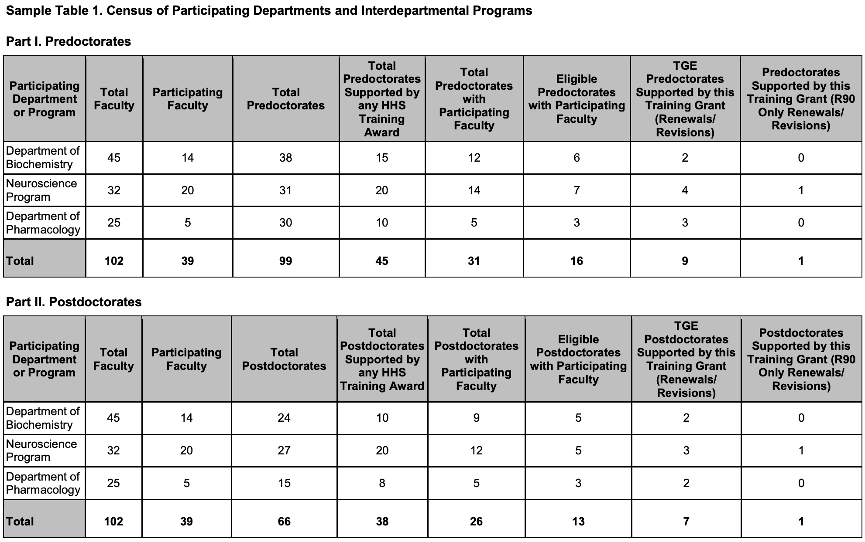
Table 1- Department Information
Notes:
For example, Table 1 contains numerical information on the participating departments of a grant.
All of the information in this table is currently entered manually since these numbers change yearly. The current process involves UCSD’s Campus Training Grant Analyst contacting all the departments heads of the departments listed on the grant and collecting the above information on both predoctorates and postdoctorates. As you can see in this example, there are only 3 departments listed, however grants often include many more departments making this an uneasy task.
Our goal is to build a database that can self-update all this information to circumvent manual input and the need to contact many individuals.

Slide 9
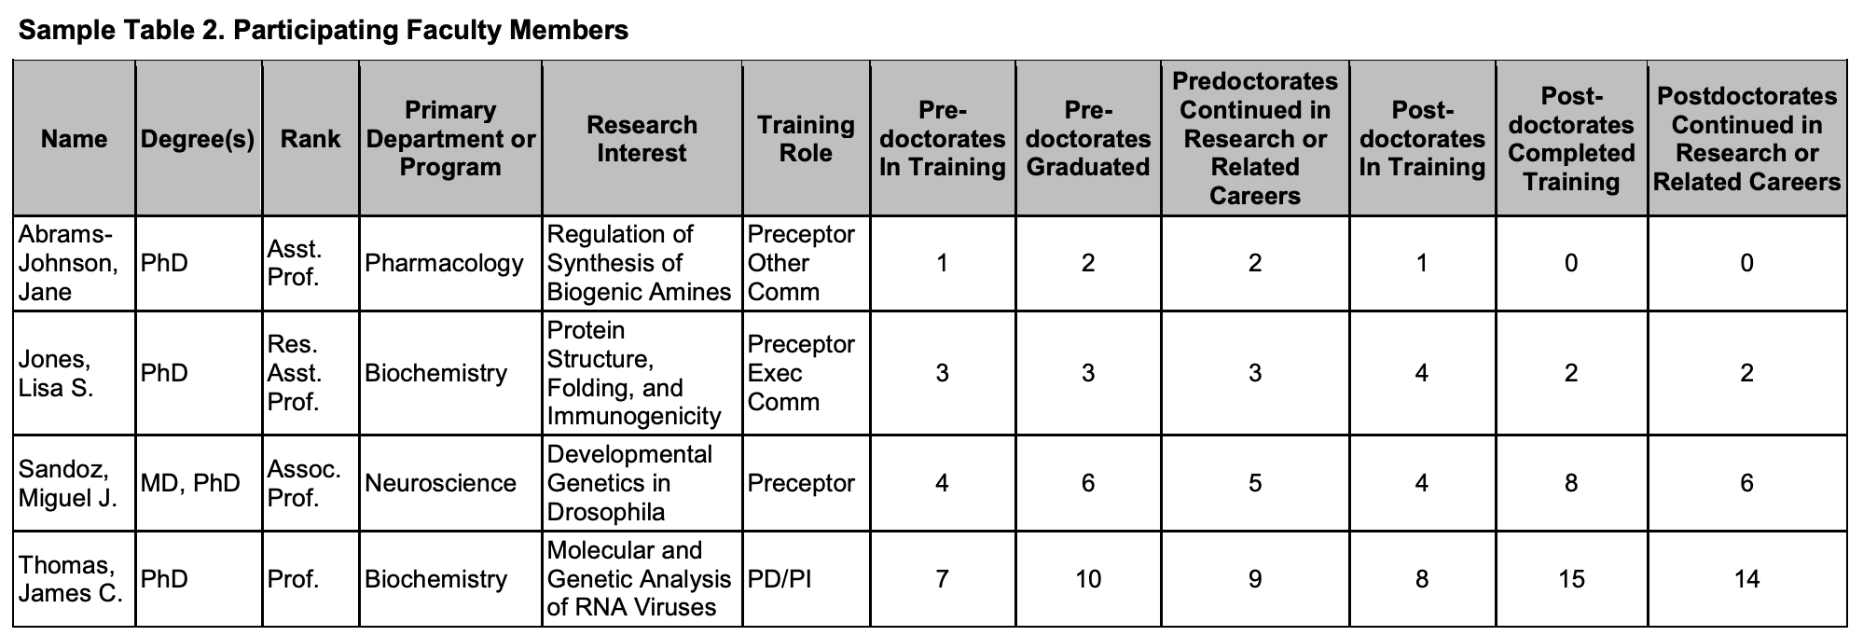
Table 2- Faculty Information
Notes:
The 2nd table is one of the hardest to collect information on. The current process is to send out an email to all the possible faculty that would be interested in being listed on the grant..then we have to copy paste their information into this table..
As you can see in this example table, there are only 4 faculty listed, but often times there are around 50 faculty listed on one grant in which case 50 emails need to be sent, and 50 rows of information must be copy-pasted.
Only one person is collecting all this data right now, Jill Weller, the Campus Training Grant Analyst.This makes this process very time consuming. We are combating this problem by having the text in the first 6 columns pulled directly from the UCSD Profiles Website which we will discuss in more detail later, and the numerical values in the last 6 columns generated by the database we created.

Slide 10
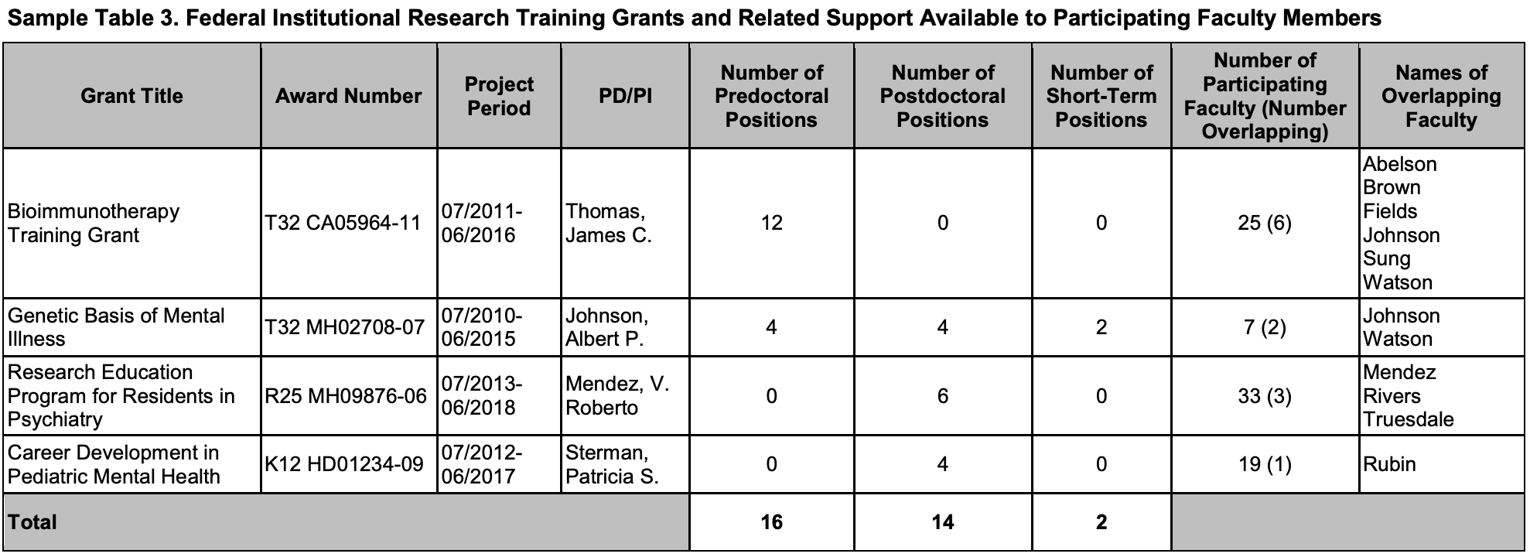
Table 3 - Department Grants
Notes:
Table 3 has a list of current federal training grants that the participating faculty from Table 2 have. Therefore, the more participating faculty listed on a grant such as in Table 2, the more training grants there will be in this table. Our goal is to upload all the information on the 47 current active grants at UCSD into our database directly so that the above information can be automatically pulled on the participating faculty members without the need to contact them.

Slide 11
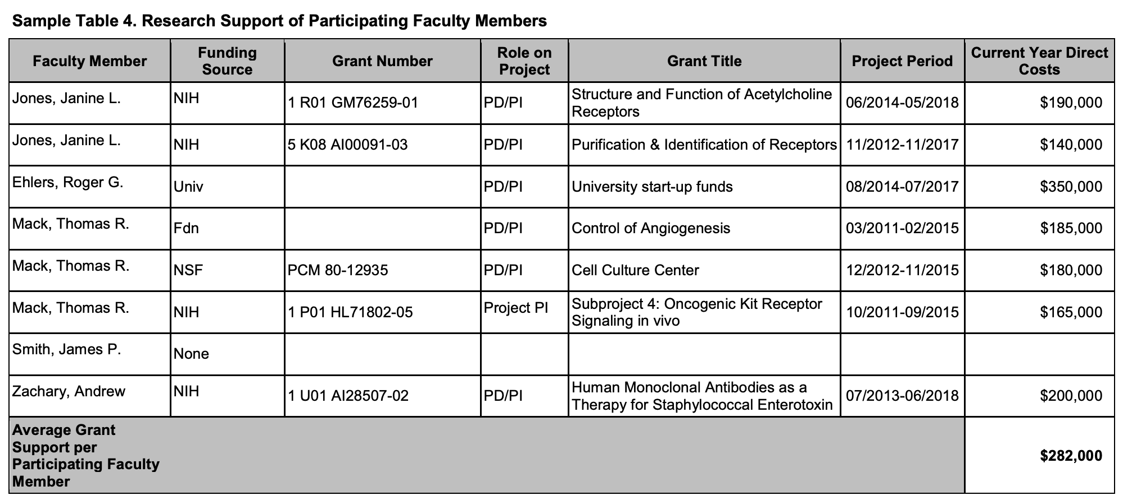
Table 4 - Faculty Research Support
Research Support of Faculty
Notes:
Table 4 differs from Table 3 in that it shows all of the current research support each faculty member is receiving to show the strength of the research environment. It is not just limited to federal training grants.
For example, here we see a grant from the university. Once again, the longer the list of participating faculty members on the grant, the longer this table will be.
You can start to see why this process becomes daunting and is often avoided.

Slide 12
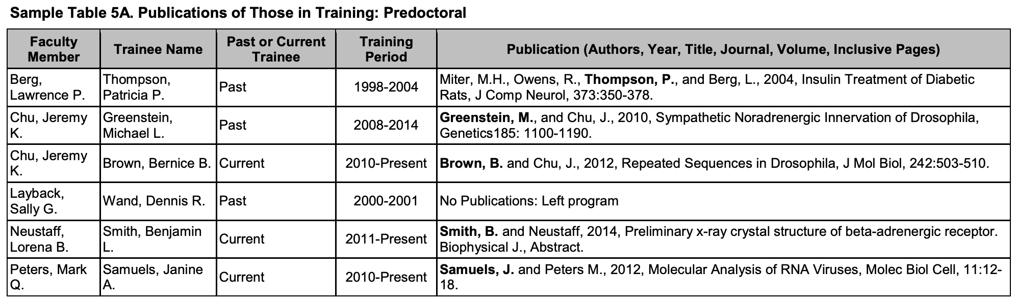
Table 5 - Trainee Publications
Notes:
Table 5 has a list of publications of the trainees assigned to each faculty member. Currently, Jill Weller is manually searching through PubMed. Our goal is to use Pubmed to self-generate this table based off a search with existing information such as trainee name, mentor name, and school affiliation.

Slide 13
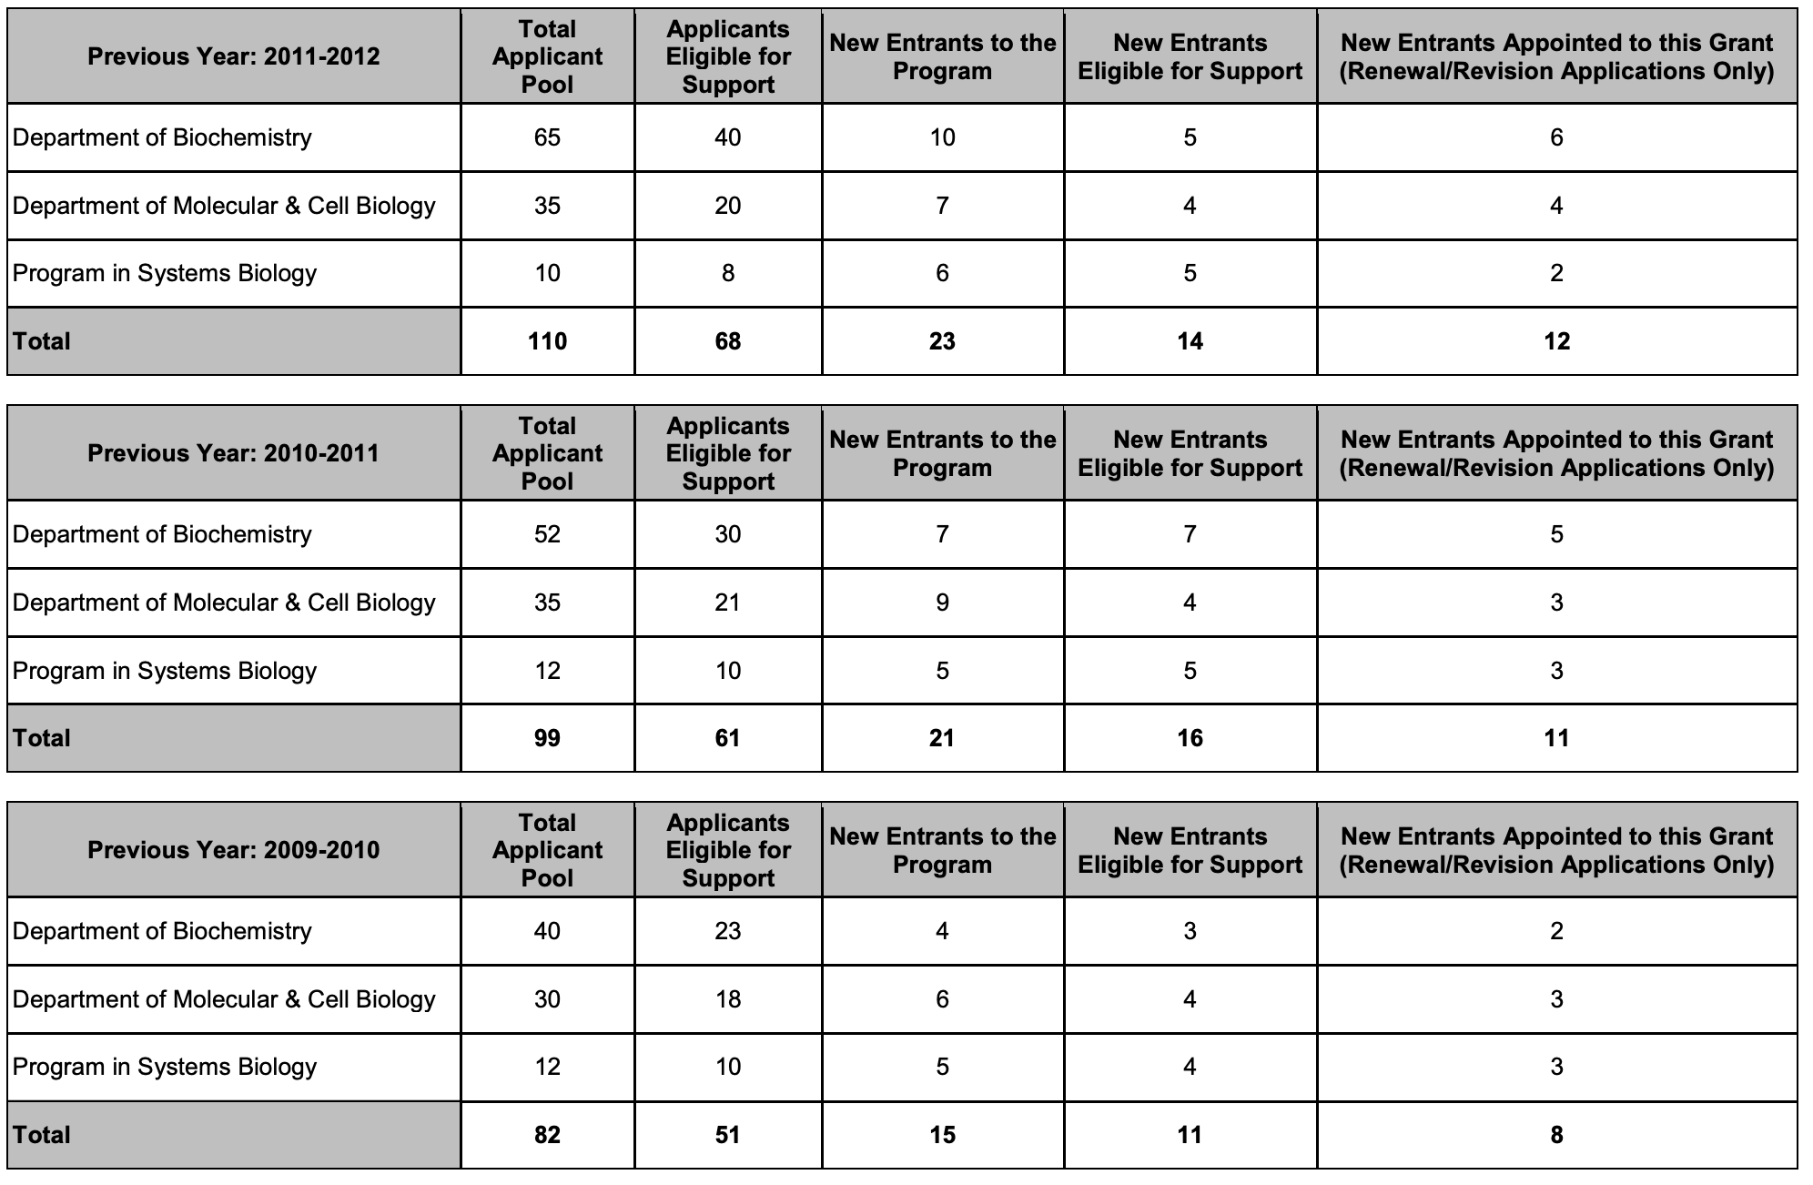
Table 6 - Applicants Info
Notes:
Table 6 has information on all the applicants who have applied to this grant in the last 5 years. Information provided in this table includes numerical calculations, applicants GPAs, and prior institutions. Our goal is to have all this information provided to us by UCSDs registrar and then store it in an easily accessible secured portion of the database to automatically create this table.

Slide 14
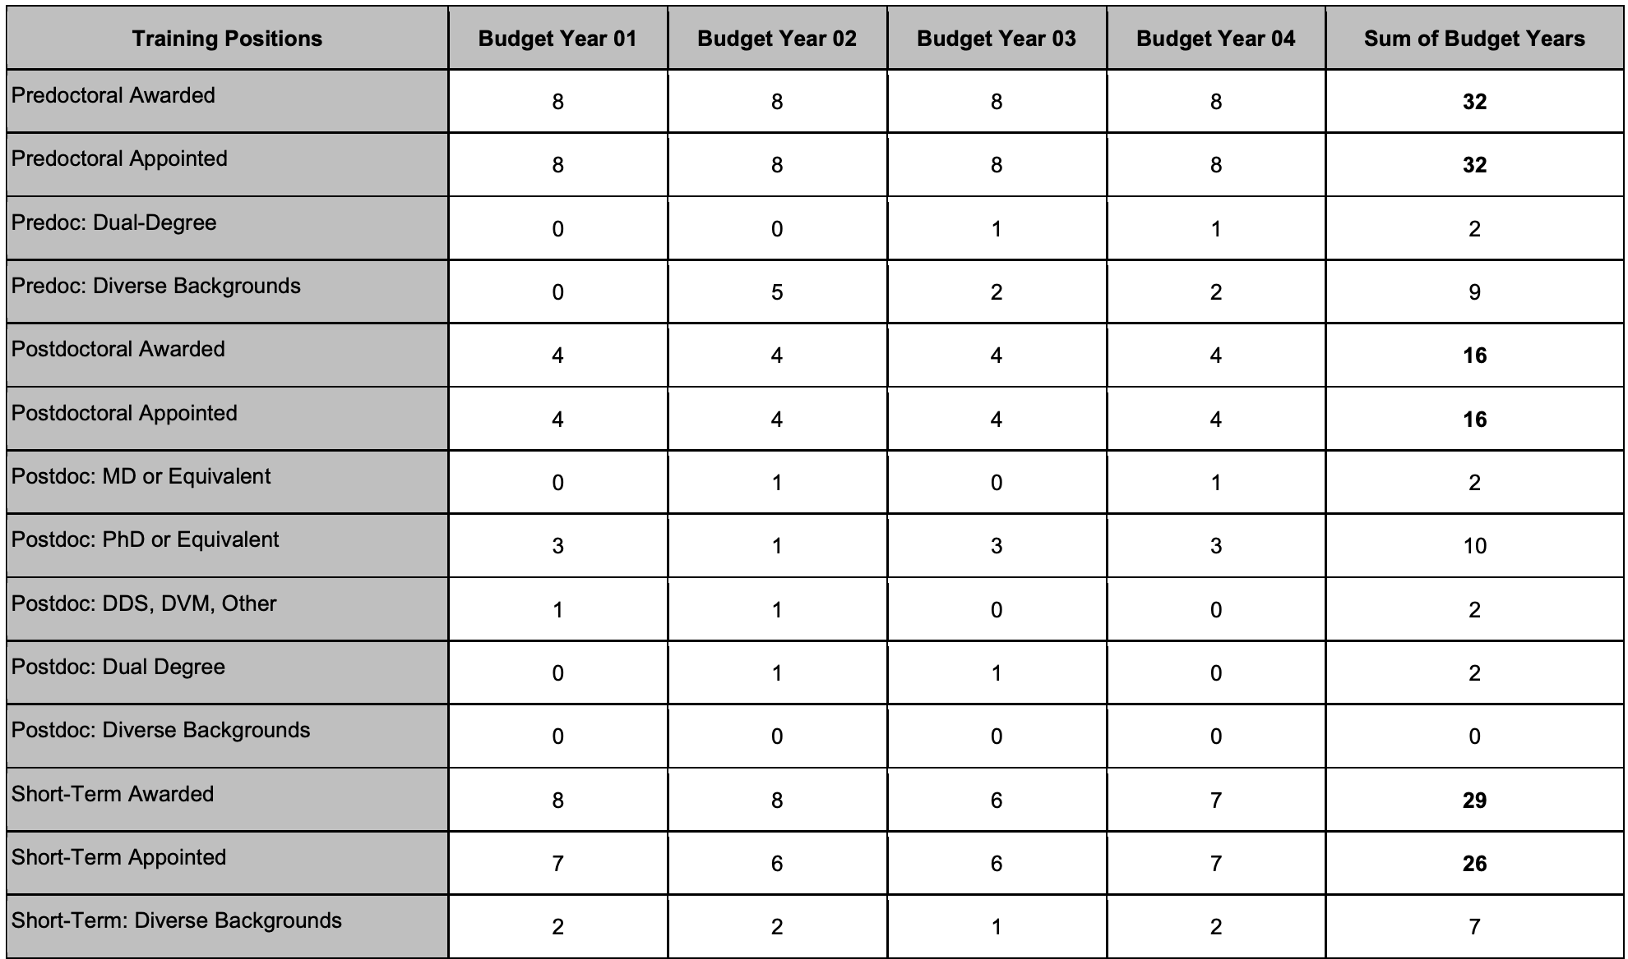
Table 7 - Appointments
Notes:
Table 7 is specifically for application renewals and revisions and contains a large number of numerical values on the number of trainees awarded for each budget year. This information is currently being entered in manually so we hope our database can eventually begin to calculate and provide these values on its own.

Slide 15
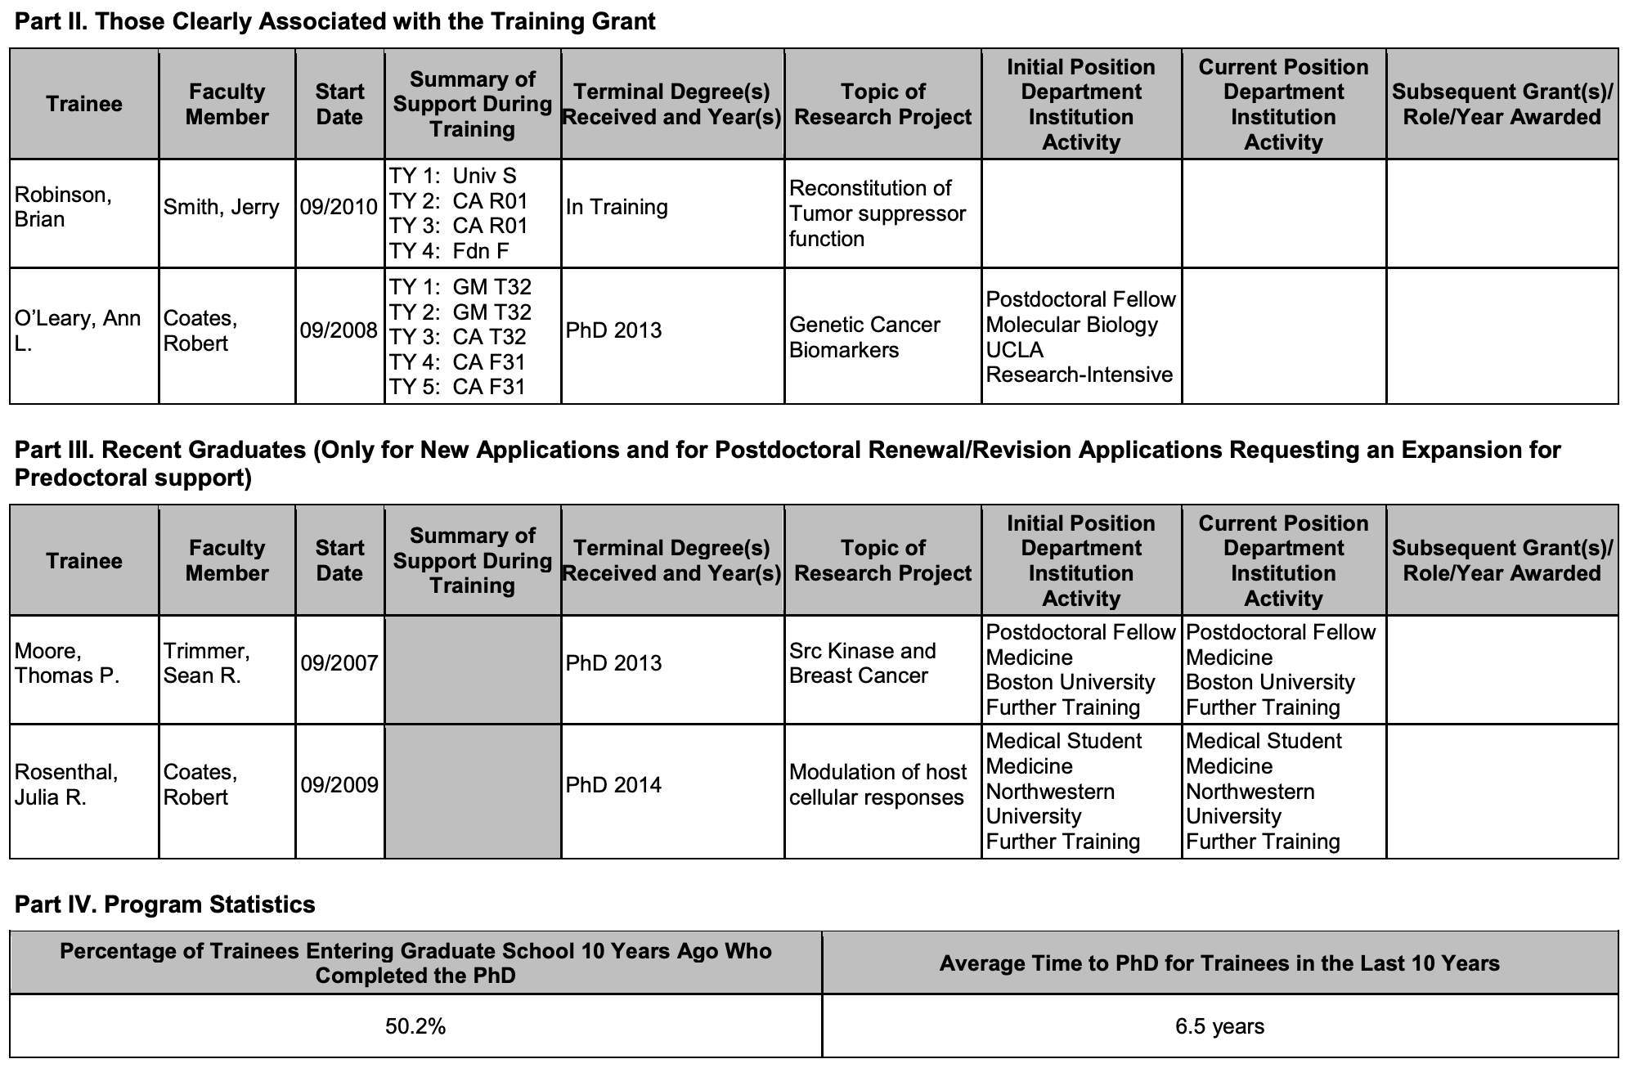
Table 8 - Trainee Information
Notes:
Table 8 contains information on the trainees clearly associated with the training grant for the last 15 years. Information that is collected and provided in this table includes, funding support, topic of research project, initial position and their current position or what they’re doing now. Currently, some of this information is being looked for across multiple platforms such as LinkedIn, Facebook and Google.
In October 2019 however, ORCID will be mandatory to use when applying for training grants. ORCID is essentially LinkedIn but for researchers, so with trainees all having a unique ORCID profile that will include all their research experience and information, this will make collecting information for Table 8 much easier.

Slide 16
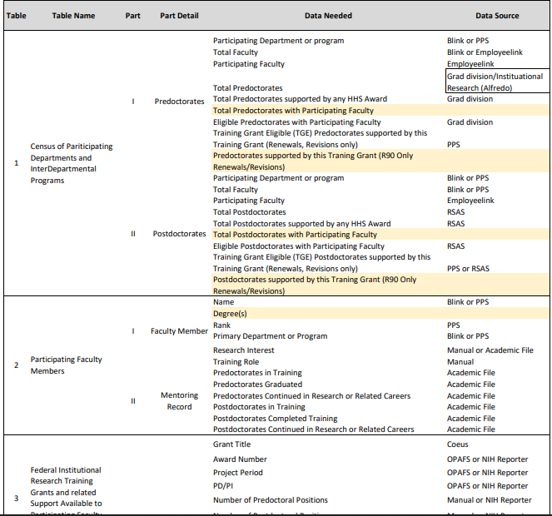
List of Data Sources
Manual Input
Academic File
Grad Division
Research Scholars Appointment System (RSAS)
Payroll Personnel System (PPS)
NIH (National Institute of Health) Reporter
Employeelink
Office of Post Award Financial Services (OPAFS)
National Center for Biotechnology Information (NCBI)
Blink
OPAFS Lookup Tool
Alumni Association
Grad Division/Institutional Research (Alfredo)
Coeus
Faculty Academic File
Notes:
We ran into a few problems with the data however.. Every piece of information that is provided in the data tables has to come from one of the 15 sources you see listed here. That means, we needed to contact and be granted access from these 15 sources which on its own was an uneasy task to complete in the 10 weeks we had for this project..
In addition to that, we ran into another problem on being granted access to this data.
In order to get access to the information in the Data Warehouse where this data is stored, we have to know the specific places in the Warehouse where this date is located. The problem here is you can’t know the locations of the data unless you can access what is in the Data Warehouse begin with...in other words, we were stuck in a Catch 22 with our data.
Therefore, we had to find another solution to circumvent this process by find other ways to gather the information needed without using these 15 sources at least for right now.

Slide 17
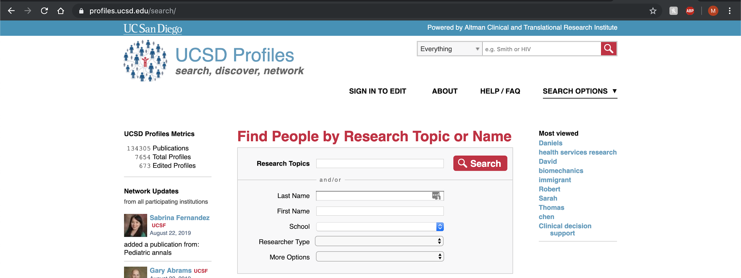
Data Sources - Solutions
Use of UCSD Profiles API (Application Program Interface)
Current Excel Files Collected by UCSD’s Training Grant Analyst
Notes:
We researched into possible solutions for this problem. Our mentor Dr. Ohno Machado redirected us to UCSD Profiles, a public interface where we can gather some of the necessary information needed on faculty members without needing access to the Data Warehouse. UCSD Profiles is relatively up to date, so even new faculty members should be listed here.
In addition to that, Jill Weller provided us with Excel files that she has been updating over the years with information on departments, grants, and trainees.
With these two main sources, we began populating our database and allowing our interface to autocomplete faculty information to lessen the amount of manual input required.

Slide 18
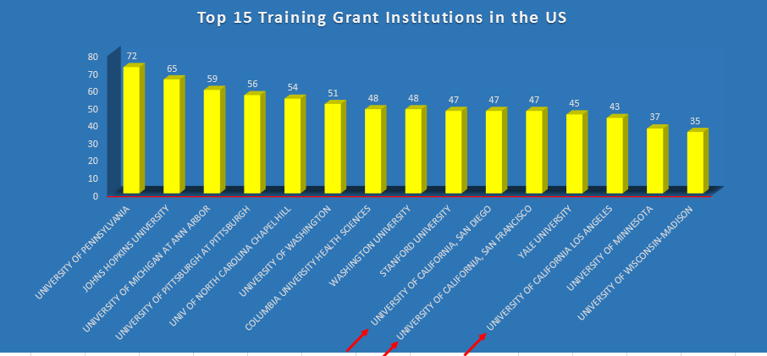
Importance and Benefits
https://pulse.ucsd.edu/departments/research-service-core/training-grants/reports-data/Pages/default.aspx
Notes:
Now you might be wondering why we need to create a program if we can already currently submit training grant applications by hand. In this graph, you can see that UCSD is among the top 15 Training Grant Institutions in the US. Currently UCSD has 47 active training grants, meaning that a lot of time and effort is spent preparing these grants.
With that said, creating an application to simplify this process will greatly save our institution time and effort and therefore increase productivity. In return, it will hopefully encourage more UCSD faculty to apply for even more training grants in the future to further strengthen our research environment!

Slide 19
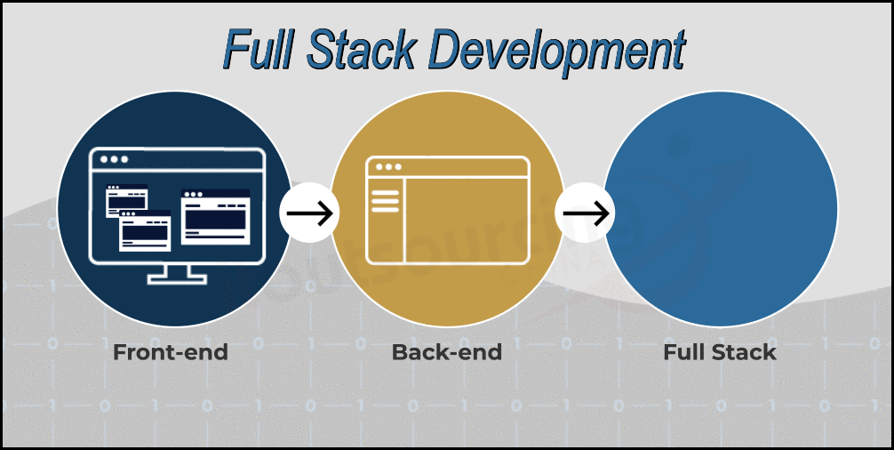
Our Solution
A full stack web application demo with a user friendly interface, and a relational database that can auto populate as much information needed for the 8 data tables
Other universities have variations of this solution such as UCSF
Notes:
So...what was our actual solution? We created a a full stack web application demo with a user friendly interface, and a relational database that can auto populate as much information needed for the 8 data tables
UCSF created their own interface to auto populate some of the 8 data tables.. it took them about 4 years to complete their interface and their database specific to the data sources of their university. Andrew and I went ahead and created a demo of a similar interface that would work seamlessly with the data sources at UCSD.

Slide 20
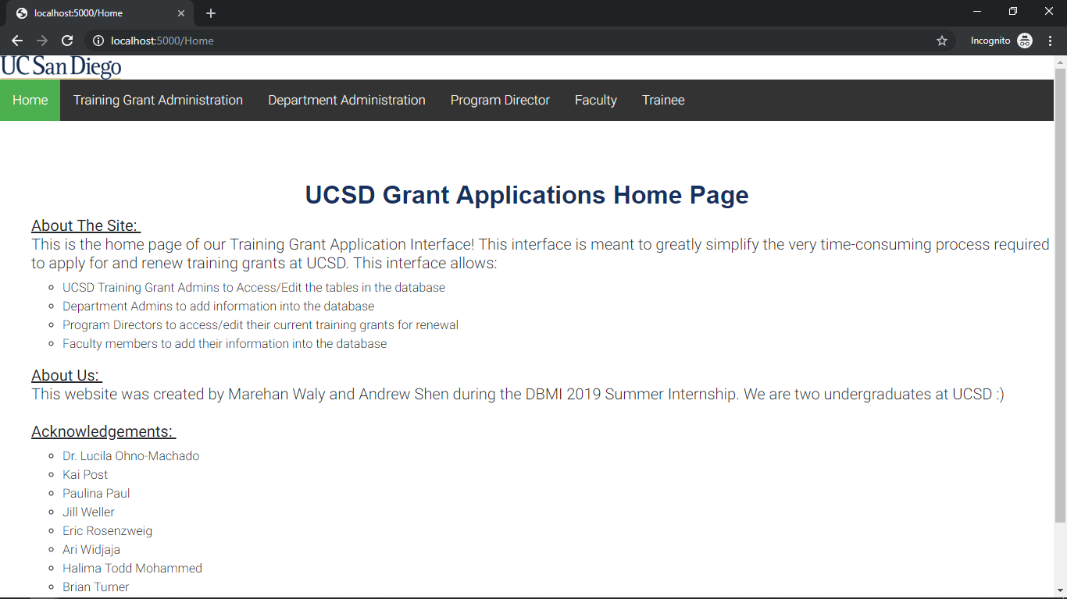
The Interface - Roles
Notes:
Let's take a look at the interface...As was mentioned previously, there are several individuals who provide the necessary information needed to submit a training grant application. With this in mind, you can see here that we created an interface to accomodate the needs of the Training Grant Administrator, Department Administrator, Program Director, Faculty Members, and Trainees. In the next few slides, we will demonstrate the interfaces available to all those mentioned above.

Slide 21
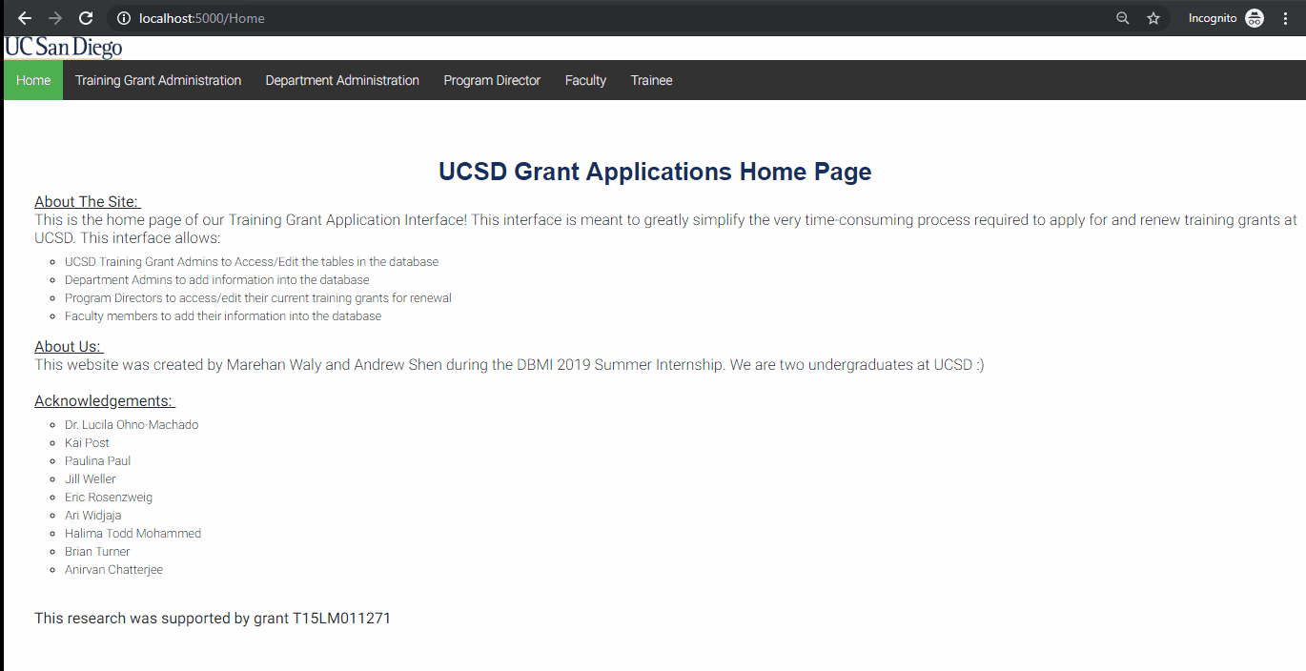
Training Grant Admin
Notes:
Here we have our Training Grant Admin Interface.
The Admin will select an existing grant from the drop down menu shown here. At the very top we see a list of the basic grant information.
Then below that we see that 5 of the data tables are being auto populated with as much information as possible from the database.
Clicking on Table 2, the training grant admin can then check that the information on the table is correct and make any last level changes before exporting the table for submission.

Slide 22
Department Admin
Notes:
Here we have the Department Admin Page.
Once they select their role as Department Admin, they can choose their department from the drop down menu and fill and then fill in the following information on the form which will then be saved to the database and then auto generate Table 1 in the required NIH format.

Slide 23
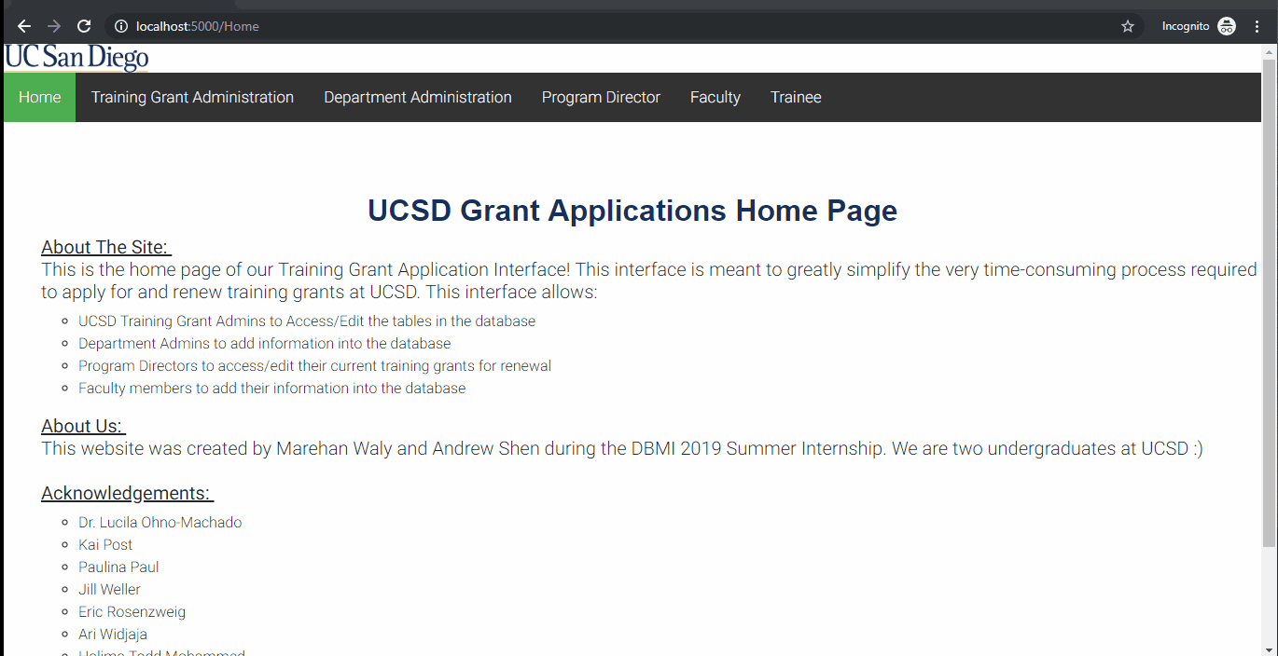
Program Director
Notes:
The Program Director is incharge of a specific grant so their interface begins with them selecting their training grant
From there they can view a list of faculty on the specific grant and edit their information directly
The information is for each faculty member here is being pre populated from the database’s existing information

Slide 24

Program Director
Notes:
The program director can also add a new faculty member to a grant by adding their name
From there the site searches through UCSD Profiles to prepopulate as much of the form as possible

Slide 25
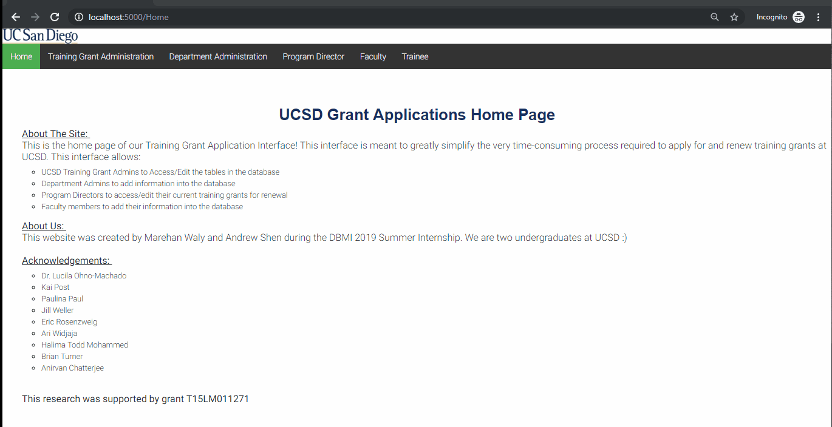
Faculty
Notes:
The faculty member has the same form as the program director where they can edit their information
The faculty member can also add Trainees and Research support under their section
In the production version they will need to sign in so their information will be pre populated just like the Program Director form

Slide 26
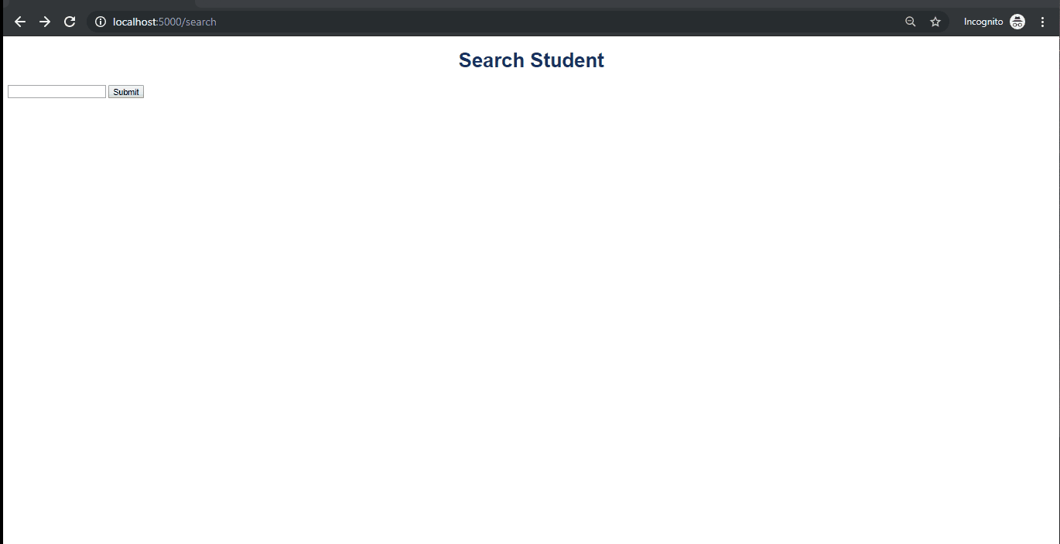
Trainee
Notes:
The Trainee Site currently features a function to search Pubmed for a trainees publications given their name
In the Production version there will be a user friendly interface where you can select certain publications to facilitate the addition and removal of any publications from this list

Slide 27



Our Application
Full Stack Web Application using:
SQL Database on Amazon Web Services
Python Web Framework
HTML, CSS, and Javascript interfaces
Notes:
The Website features three main technical aspects: The Database, The Framework, and The Front End
We will go more into detail about what each of these sections does

Slide 28
Full Stack Development
HTML Interface/Website
CSS + Javascript Server and Client Interaction
Python Web Framework
SQL Database
Notes:
The bottom of the stack is our SQL database. SQL, or Structured Query Language not only allows us to store data but access, modify, and manipulate the data through queries, hence the name
From there we have our Framework where everything is gathered and organized. The framework is able to pull information from all the various sources such as SQL, UCSD Profiles, and Pubmed and collect it in an organized fashion.
Then the information passes into the CSS or cascading style sheets which allows us to format the website and the javascript which allows us to have a more usable interface. This is what renders all the forms and tables in the style as seen by the user
HTML is the interface that directs the users where to go and both connects and separates each page of the website

Slide 29

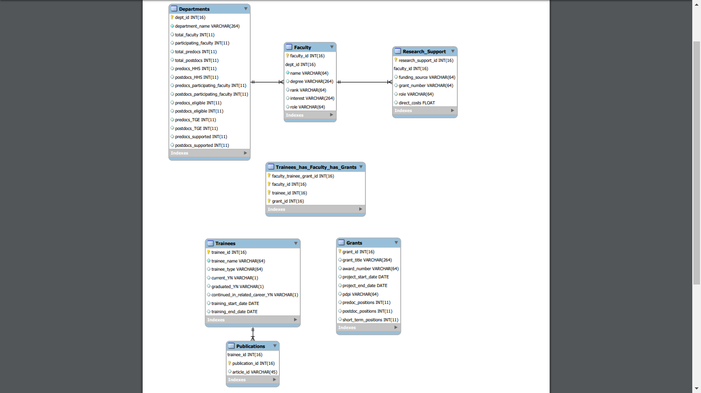
Data normalization to remove redundancy and breaks tables down into smaller sections
Self updating when any information is entered
Notes:
SQL is where all the data that is needed to generate all 8 tables will be stored.
Here is what the first 5 Tables looks like in the SQL database. As you can see there are much more than 5 individual tables.
This is because all of the data in our database is normalized.
This means that any redundancies are removed and tables are split up into smaller sections
This normalization also allows sections to be self updating so when 1 piece of information is input, others change automatically
This minimizes the amount of work needed when adding or updating certain values

Slide 30
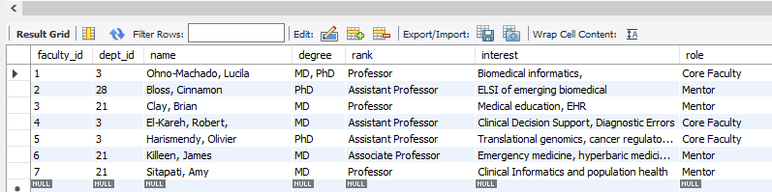
Data Storage and Access
Easy to access for programs but not for people
Organized format however can be difficult for humans to read
Notes:
Although SQL makes it easy to store data, it is not the most intuitive to edit or access.
For example here is an example of the faculty table.
Certain values can be difficult to decipher for instance, the column dept_id only contains a numerical value for the name of the department
That means that the number must be translated into an understandable name if someone were to look into the database directly

Slide 31
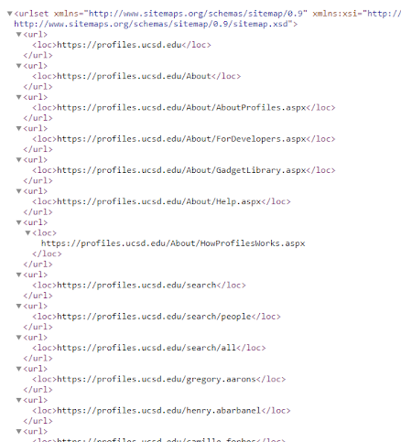

Converts Database into understandable format
Contains the framework and map for the website
API Access for UCSD Profiles and Pubmed
Notes:
Python is what converts the SQL Database into an understandable format
Python also contains the Web Framework Flask that contains the site layout and structure.
We chose Flask because it is a very lightweight framework meaning that its not only easy to learn but also runs quickly and can be setup very fast, which is perfect for our demo. We also chose SQL because it is not only capable of storing lots of data efficiently but also is very easy to integrate into languages like Python

Slide 32
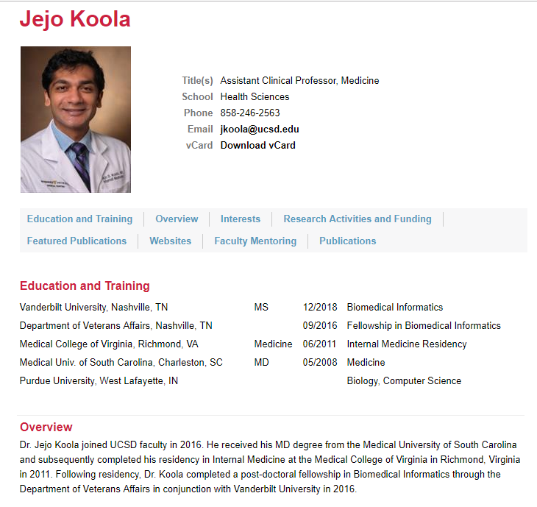
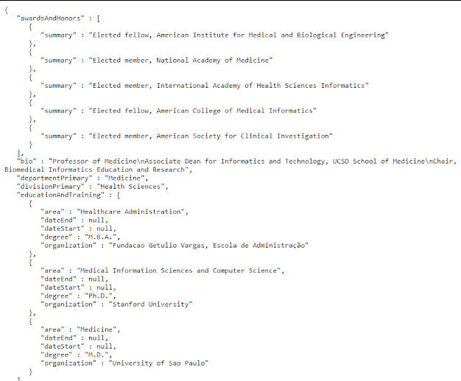
UCSD Profiles API
Notes:
Along with pulling data from SQL, Python can also pull data from other sources.
One important source being UCSD Profiles
The reason why profiles is so important is that it contains a great deal of the required information about each faculty member such as
Education
Interests
Research
Publications
The API or application program interface allows us to turn a profile as seen on the right into raw data in the form on the left
This allows us to use that information to prepopulate forms and add faculty directly to the database
Pubmed also shares a very similar API which is being used in the trainee publication section.

Slide 33
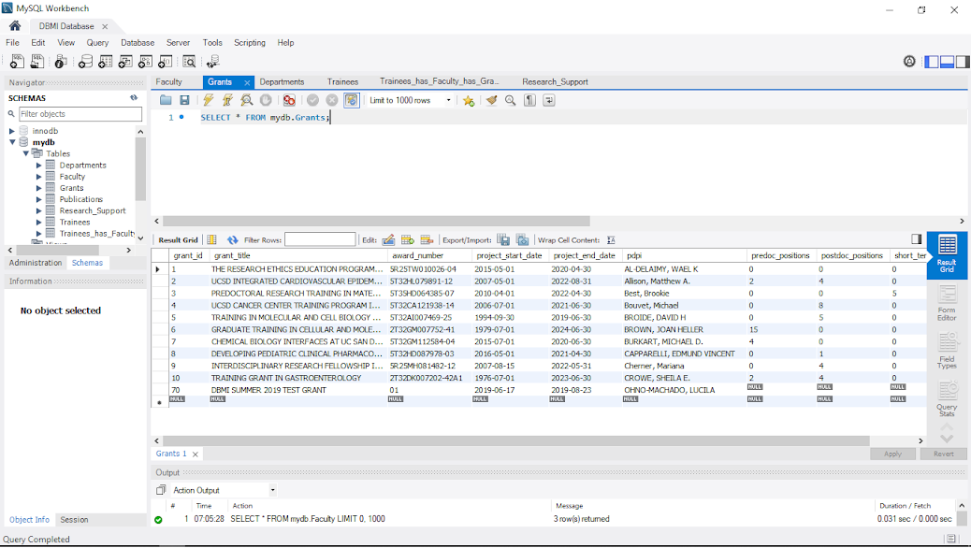
HTML, CSS, and Javascript
Notes:
The HTML, CSS, and Javascript is being used to display the Python and SQL in a very user friendly manner
For example here is the SQL interface which as you can see for a faculty member or trainee this is very confusing, hard to navigate, and lacks many functions for their position
Instead we can transform this table into ...

Slide 34
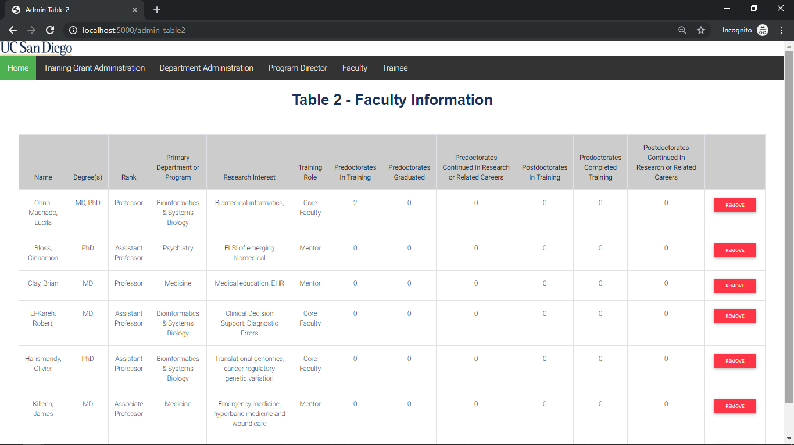
HTML, CSS, and Javascript
Notes:
Something that looks like this.
Here the data is presented exactly as the NIH requires and allows modification directly in each individual cell for last level edits

Slide 35
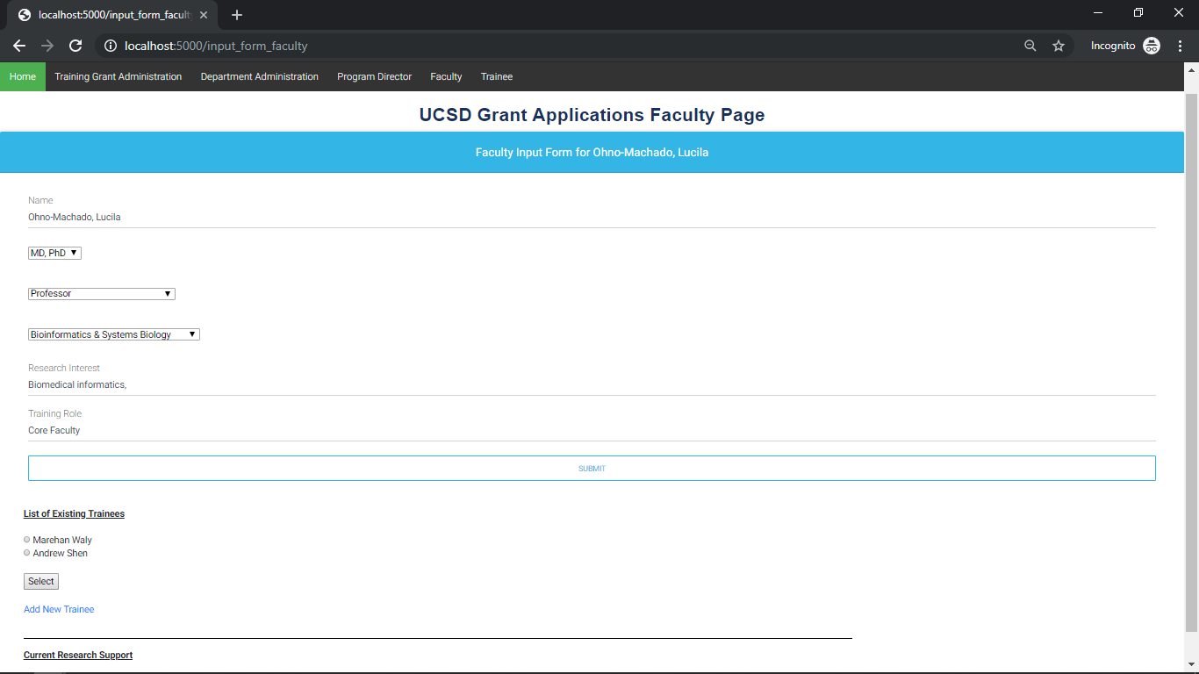
HTML, CSS, and Javascript
Notes:
The HTML, CSS, and Javascript also allows us to create simple forms that directly collect information for storage in the database.
Here a faculty member would know exactly what to input and the form allows admins to avoid asking faculty for redundant information especially if a faculty member is listed on more than one grant, this form eliminates the need to contact a faculty member several times to provide the exact same information

Slide 36
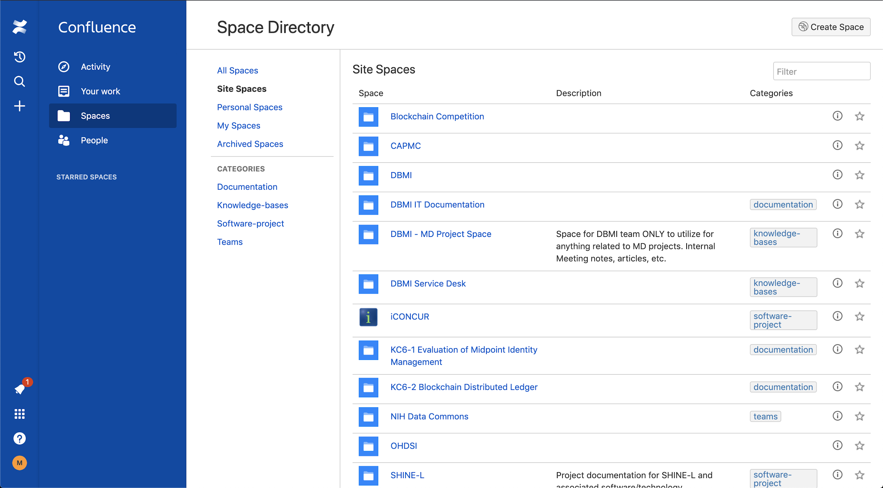
Documentation
Notes:
With all this code, it is very important to document all of our work.
This includes adding comments, explaining functions, site walkthrough, and data + code turn-in
Documentation is also very important as our site is a demo of what a full production version would look like.
By recording our work it makes it easier to hand off our work to a production team who can understand what we did and then allow them to easily add more features in the future such as ...

Slide 37
Future Plans
Get all 8 Tables functioning on the site
Ability to save drafts and edits for later use
Database cleaning, restrictions, and security
Faculty Sign-in Page and auto redirection to subpages
Ability to email notifications to faculty and trainees
Notes:
Adding functionality for all 8 tables, as currently the website is focused on the first 5
The ability to save drafts in incomplete grant applications as they are 300+ pages and require a long timeline
Increasing the data cleanliness, by catching incorrect spellings and impossible values
Personalizing and securing the site through a faculty and student sign on page, allowing them access only to specific pages
And the ability to email faculty and trainee about important notifications

Slide 38
What We Learned
Programing
Python (Flask, APIs)
HTML, Javascript, and CSS
Database
Relational Database Design
SQL and MySQL Workbench
Logistics
Front end Design
Amazon Web Services
Documentation
Notes:
Python was the primary programming language that we worked with and specifically the Flask Web Framework and APIs
HTML, Javascript, and CSS was something that we worked a lot with when designing our interface
In terms of Database work, we learned how to setup and normalize a relational database and access it through SQL workbench and SQL queries
Lastly, we learned a lot about front end design and making a clean and clear interface, setting up and accessing a Amazon Web Server
and most importantly documentation, which is not something often taught in the classroom setting.

Slide 39
Acknowledgements
Dr. Lucila Ohno-Machado
Kai Post
Paulina Paul
Jill Weller
Eric Rosenzweig
Ari Widjaja
Dr. Jejo Koola
Dr Tsung-Ting Kuo
Elizabeth Santillanez
Nancy Herbst
Questions?
Notes:
We’d like to greatly thank all of our mentors who have been a great source of guidance and advice for the last 10 weeks. In addition, we’d like to thank the DBMI staff that made this internship possible, we’ve gained a great deal of valuable information and experience during this internship.
Now, Marehan and I will answer any questions.

